Slide 1



Linux
Admin I
Chapter 02
Presented by: Mohamed Fakhruldeen

Slide 2

02. Accessing CLI
Log in to a Linux system and run simple commands
using the shell.

Slide 3
Outline
Accessing CLI
Accessing the Command Line
Accessing the CL Line Using the Desktop
Executing Commands Using the Bash Shell

Slide 4

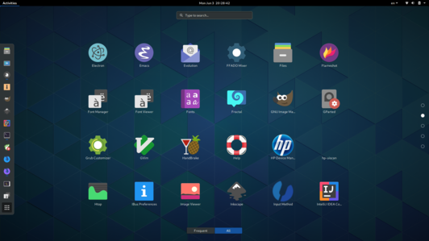
GUI
Graphical Interface

